Slide 1


Project 1
Comparative analysis of Ohio graduation rates and select social economic data, 2002 - 2018
Project Group: Jasmine Jones, Neda Mehdizadeh, Anthony Stevens & Benjy Manning

Slide 2
Outline
Introduction/Objective
Tasks
Cleaning data sets
Merging data sets
Visualizing the data
Statistical analysis
Results and discussion
Conclusions

Slide 3
Objective
Comment(Delete for final):
Jasmine adding library graphic
Investigation of the relationships between the college graduation rate, family income and poverty rate in the state of Ohio using the following Python Libraries:

Slide 4
Sources of Data
Three data sets were obtained, merged and cleaned in the Jupyter notebook with Pandas library:
Median Income and Unemployment data was obtained from the USDA online: (https://www.ers.usda.gov/data-products/county-level-data-sets/download-data/ )
Ohio College Graduation data was obtained from the Ohio Department of Higher Education: (https://www.ohiohighered.org/data-reports/degrees)
Poverty rate data was obtained from the US Census bureau: (https://www.census.gov/data-tools/demo/saipe/#/?map_geoSelector=aa_c&s_state=39&s_year=2019,2018&s_measures=aa_snc&map_yearSelector=2018 )

Slide 5
Initial thoughts on data
We did not expect to be such a large correlation between median income and number of degrees earned.
No expected correlation between poverty rate and degrees earned.
As degrees earned rises, the unemployment rate goes down.

Slide 6
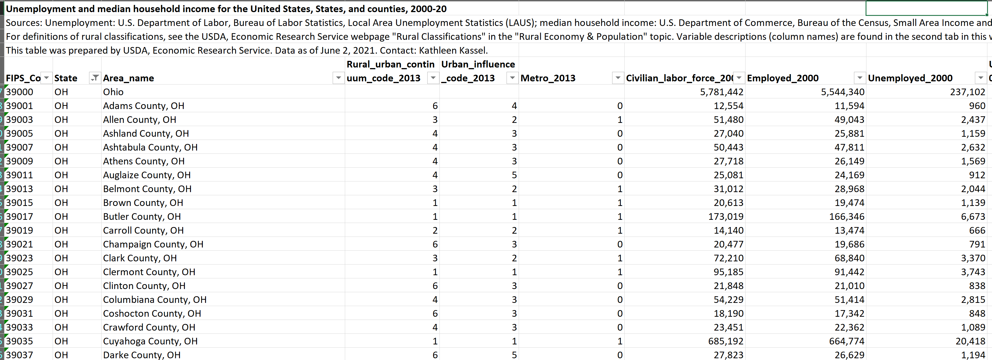
Unemployment and Median Income Data Set

Slide 7
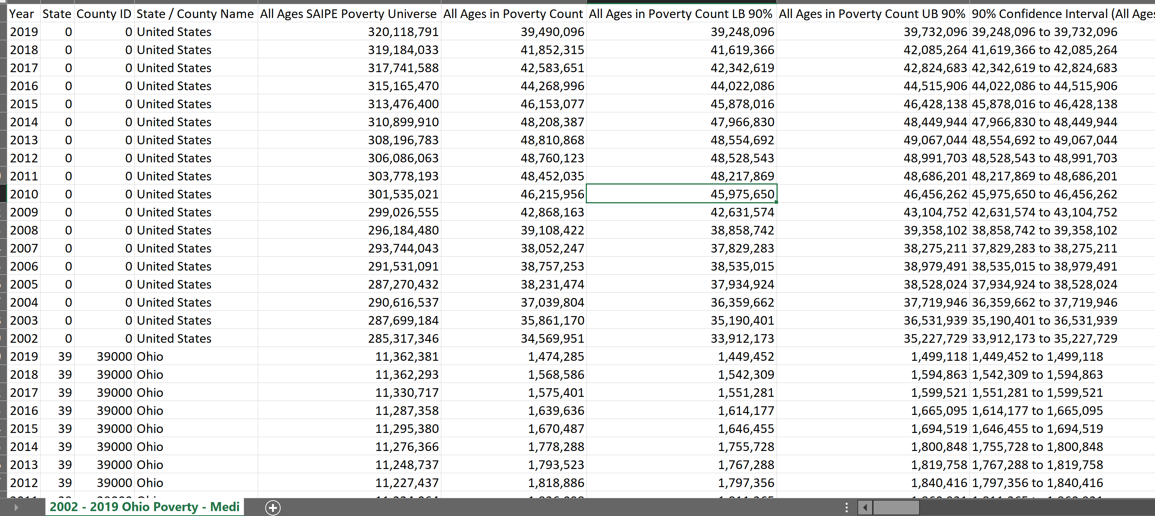
Poverty Data Set

Slide 8
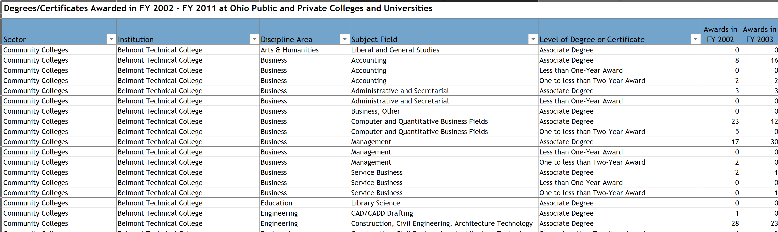
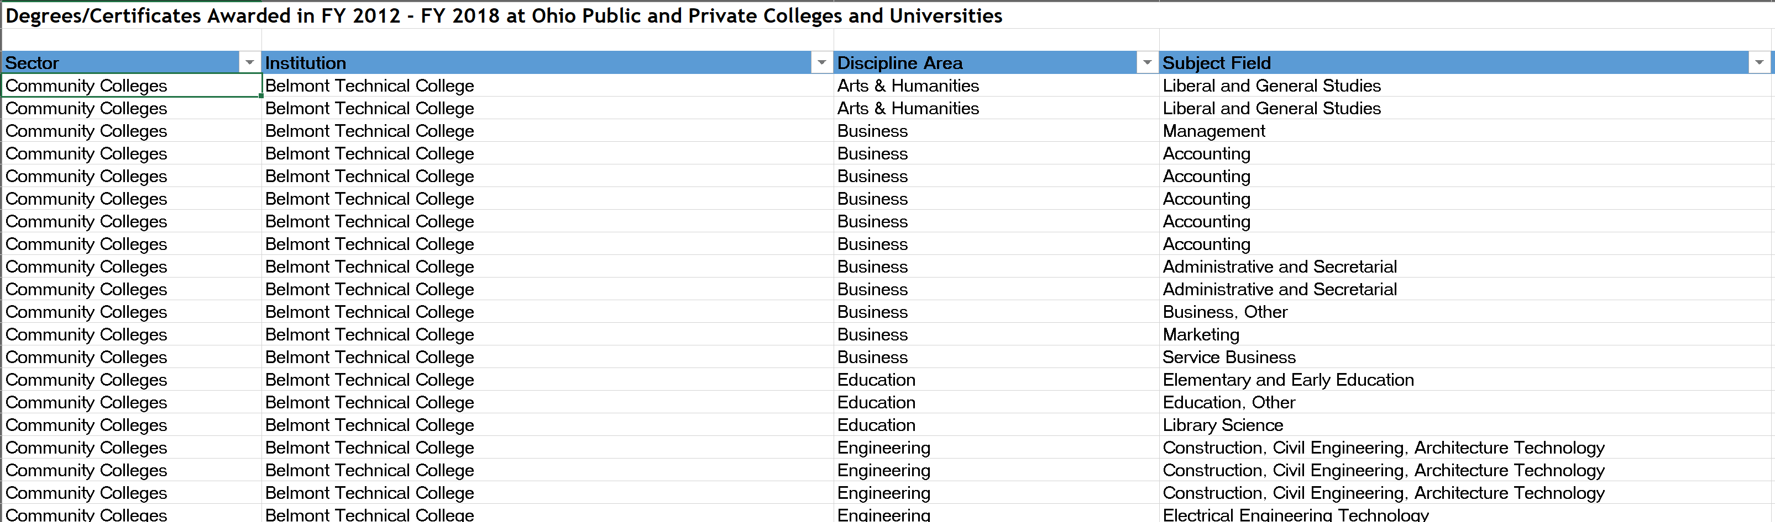
College Graduation Data Set

Slide 9
Data Import and Cleaning

Slide 10
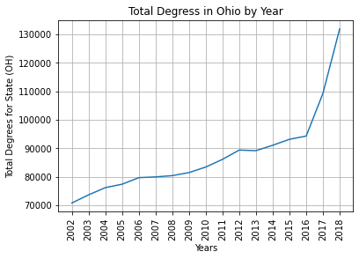
Data Analysis Observations – Total Degrees by Year

Slide 11
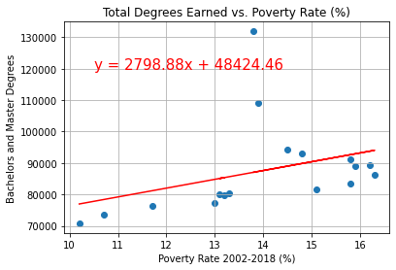
Question 1: Does the poverty rate have an impact on the number of degrees earned from 2002-2018 in Ohio?
In review

Slide 12
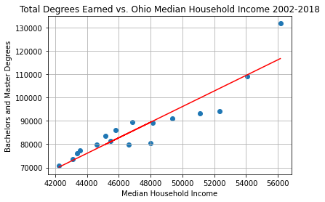
Plot x Overview

Slide 13
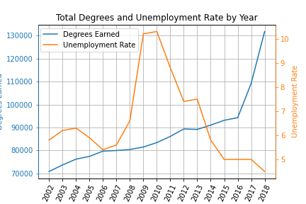
Plot x Overview

Slide 14
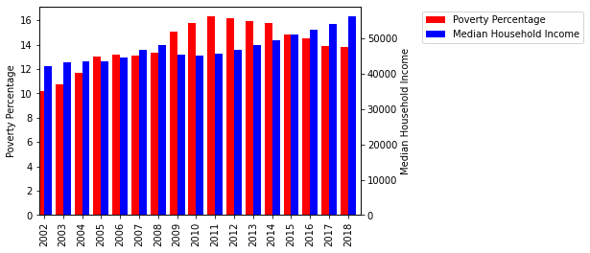
Plot x Overview

Slide 15
Project Conlusion

Slide 17
Sample Data Sets

Slide 18
Sample Data Sets

Slide 21
Sample Data Sets

Slide 25

Thank you for your attention!

